Slide 1
15CSE302 Database Management Systems Lecture 1 Introduction B.Tech /III Year CSE/V Semester L T P C 2 0 2 3
DBMS Team
Dr G Jeyakumar
Bindu K R
Dr Priyanka Kumar
R. Manjusha
Department of CSE
Amrita School of Engineering

Slide 2
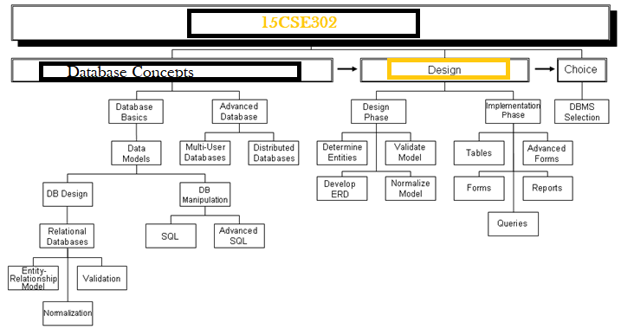
Syllabus

Slide 3

Contents
Database Terminologies
Database System Applications
Purpose of Database Systems
Views of Data
Components of a DBMS

Slide 4

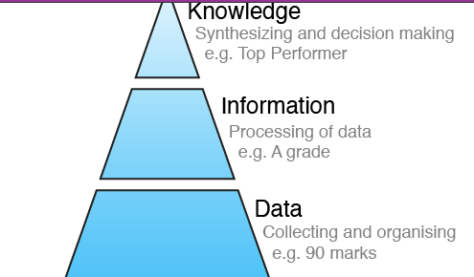
Database Terminologies
Data, Information and Knowledge
DATA

Slide 5
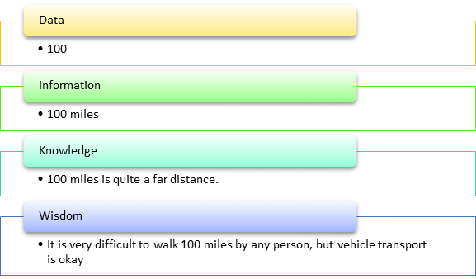
Database Terminologies
Data, Information and Knowledge

Slide 6
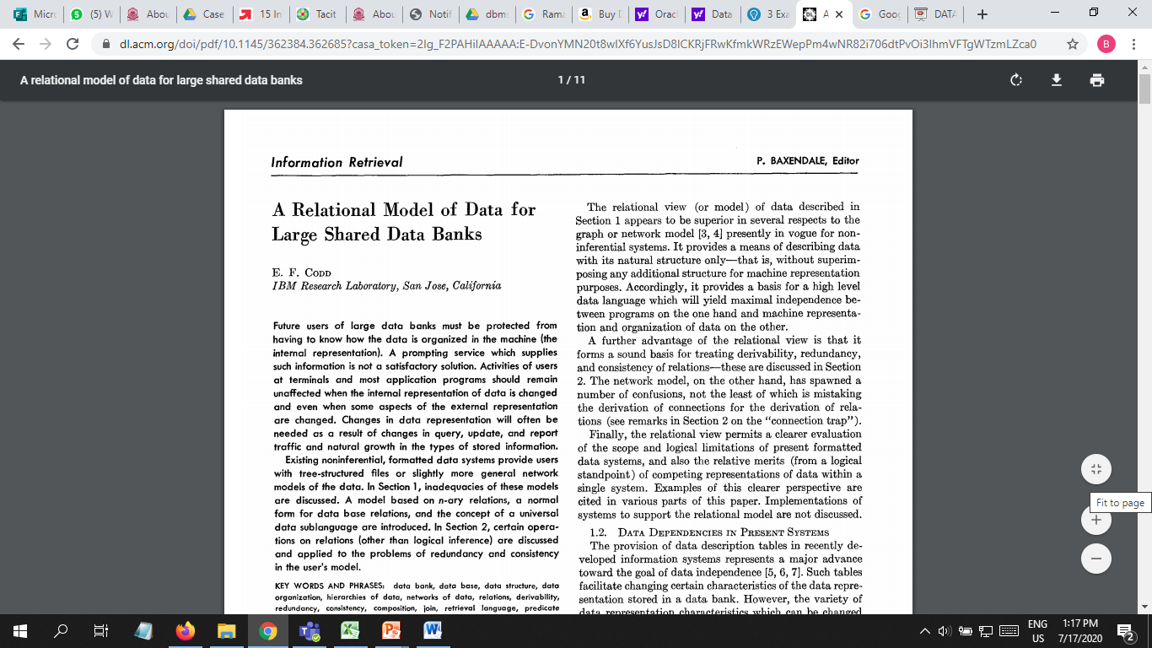
Edgar F. Codd 🡪Creator of Databases
E. F. Codd first described relational database theory in his landmark paper “A Relational Model of Data for Large Shared Data Banks,” published in the Communications of the ACM (Association for Computing Machinery) in June, 1970. https://dl.acm.org/doi/pdf/10.1145/362384.362685
E.F. Codd passed away on April 18, 2003, at the age of 79

Slide 7
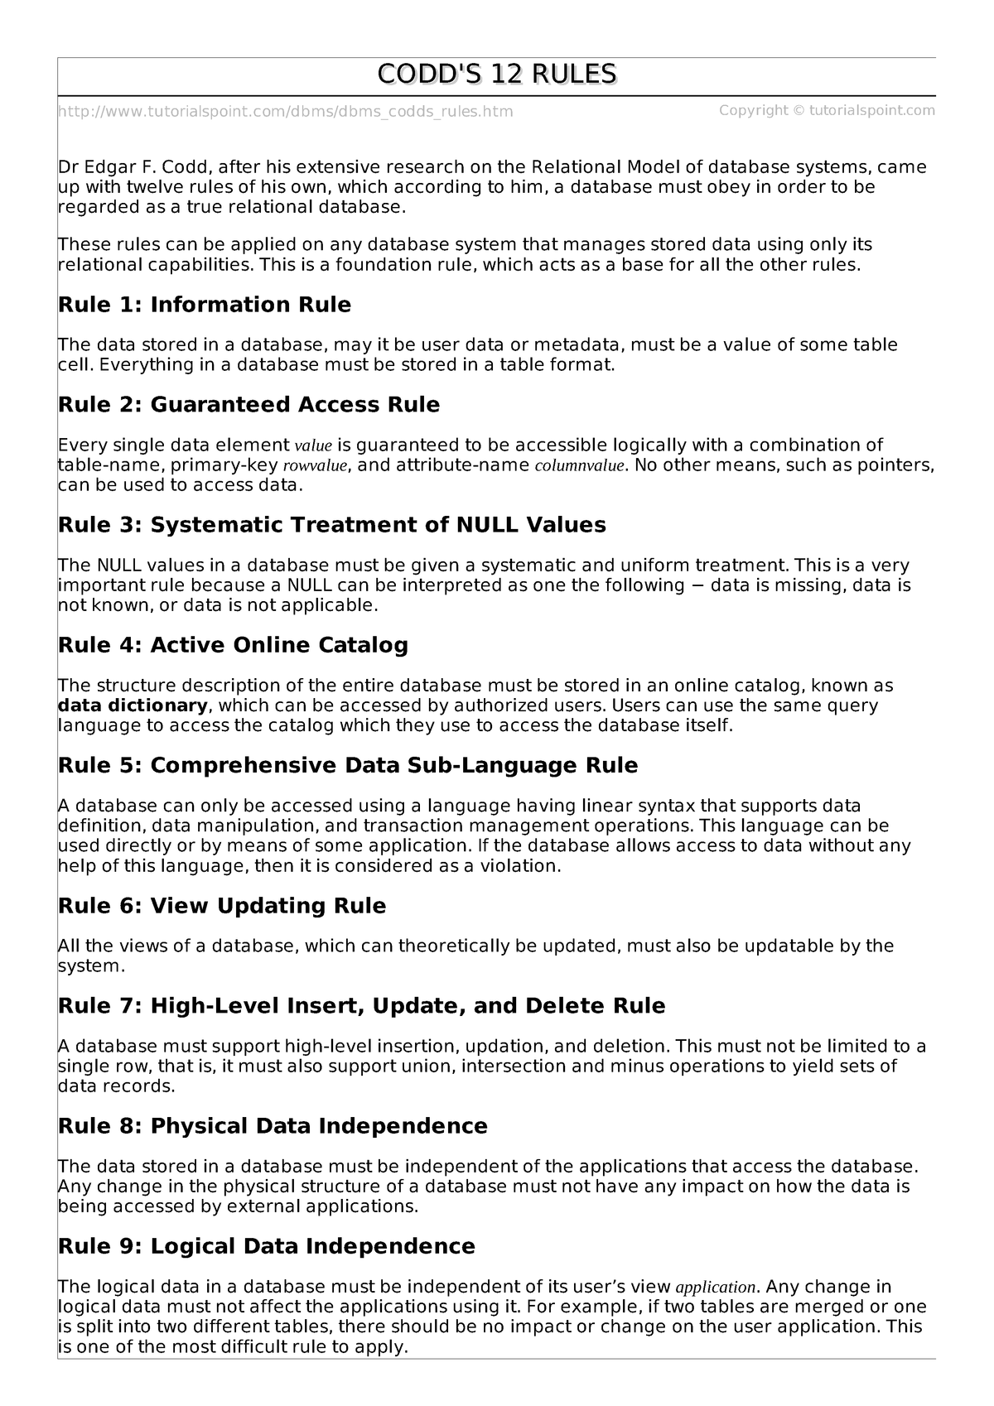
Codd's rules
Codd's 12 rules are a set of thirteen rules (numbered zero to twelve) proposed by Edgar F. Codd, a pioneer of the relational model for databases, designed to define what is required from a database management system in order for it to be considered relational
i.e., a relational database management system RDBMS

Slide 8
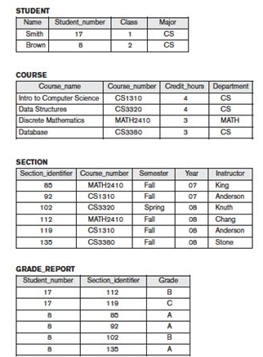
Terminologies
A Database is a shared collection of logically related data and description of these data, designed to meet the information needs of an organization.

Slide 9
Terminologies
A Database Management System is a software system that enables users to define, create, maintain, and control access to the database
DBMS = Data + Program
Data – refers to the database.
Goal of DBMS - To provide a way to store and retrieve database information that is both convenient and efficient.

Slide 10
Terminologies
Database Management System
Management of data involves
Defining the structure for the storage.
Providing mechanism for manipulation.
Ensuring safety from unauthorized access.
Providing data sharing – for multiple user.
Computer Scientist have developed a large body of concepts and techniques for all the above – Learning them is the objective of this course

Slide 11
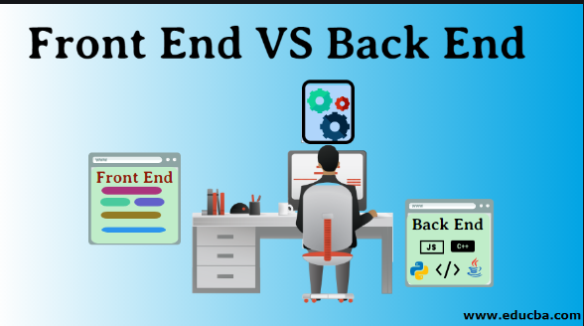
Terminologies
Database Systems typically have high cost and they require high end hardware configurations.
An Application Program interacts with a database by issuing an appropriate request (typically a SQL statement)

Slide 12

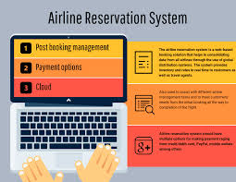
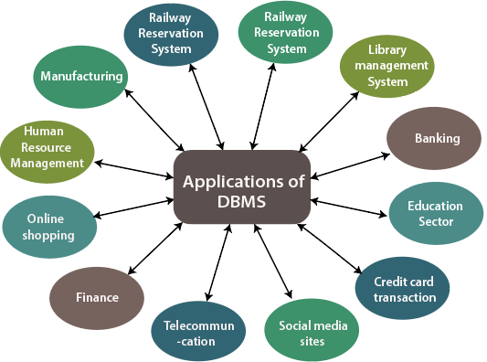
Database Applications
Banking: transactions
Airlines: reservations, schedules
Universities: registration, grades
Sales: customers, products, purchases
Online retailers: order tracking, customized recommendations
Manufacturing: production, inventory, orders, supply chain
Human resources: employee records, salaries, tax deductions
Notes:
12

Slide 13
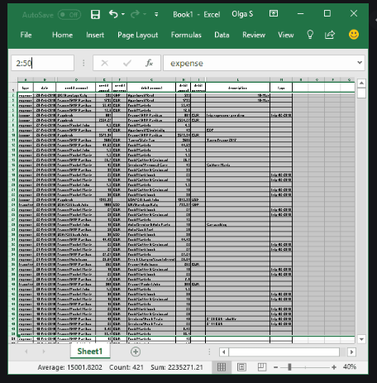
Purpose of Database Systems
Data used to be stored in flat files and can be accessed using any programming language.
The file based approach suffers following problems:
Dependency of program on physical structure of data
Complex process to retrieve data
Loss of data on concurrent access
Inability to give access based on record (Security)
Data redundancy

Slide 14
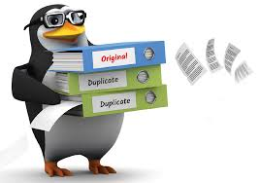

Drawbacks of using file systems to store data
Data redundancy and inconsistency
Difficulty in accessing data
Data isolation
Integrity problems
Atomicity of updates
Concurrent access by multiple users
Security problems
Database systems offer solutions to all the above problems
Notes:
14

Slide 15
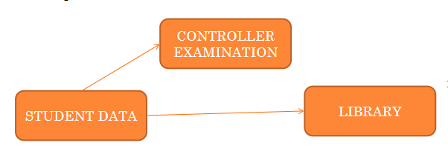
Data redundancy and inconsistency
Data redundancy and inconsistency
Redundancy leads to inconsistency… Eg, Updating student address.
Notes:
15

Slide 16
Difficulty in accessing data
File processing is very difficult.
Notes:
16

Slide 17
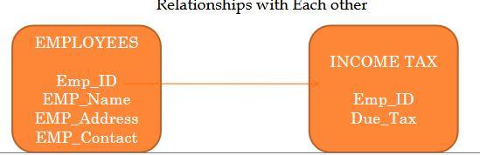
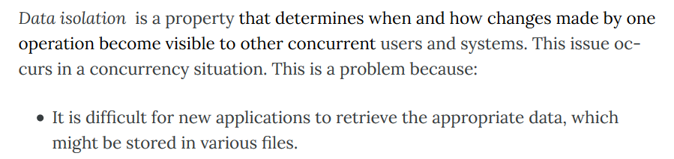
Data isolation
Data Isolation Means Scattered Data
Notes:
17

Slide 18
Data Integrity
Data Integrity Deals with the Correctness and Accuracy of Data.
The data values stored in the database must satisfy certain consistency constraints.
E.g. Age Limit to Apply for a Job should be less than 30.
Roll Number cannot be Negative.
Setting such constraints are difficult in files.
Notes:
18

Slide 19
Atomicity Problem
Computer is subject to failure.
If a failure occurs, the data to be restored to the consistent state, that existed prior to the failure.
Eg. Transaction – Transferring money from one account to another account.
This transaction to be atomic – it must happen in its entirely or not at all.
It is difficult to ensure atomicity in a file systems.

Slide 20
Concurrent Access Anomalies…
Many systems allow multiple users to update the data simultaneously.
Eg. Online shopping, online course registration etc,
This concurrent updates may result in inconsistent data.
Account A – Balance $1000
(1) Clerk A (2) Clerk B
Debit: 900 Credit: 400
Balance: 9100 (or) Balance: 9600
…it should be 1000 –(900+400) = 8700
DBMS has solution for these anomalies.

Slide 21
Security Problems…
Not every user of a system need to access all the data.
Eg. A student need not have access to faculty salary information.
Setting such security constraints is difficult in file systems.
DBMS have solutions.

Slide 22
Drawbacks of using file systems to store data
Data redundancy and inconsistency
Difficulty in accessing data
Data isolation
Integrity problems
Atomicity of updates
Concurrent access by multiple users
Security problems
Database systems offer solutions to all the above problems
Notes:
22

Slide 23
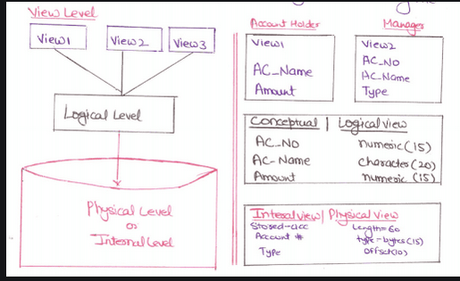
Views of Data
A database system is a collection of interrelated data and a set of programs that allows the user to access and modify those data.
A major purpose of database system is to provide user with an abstract view of data.
Data Abstraction
Physical Level
Logical Level
View Level
Notes:
23

Slide 24
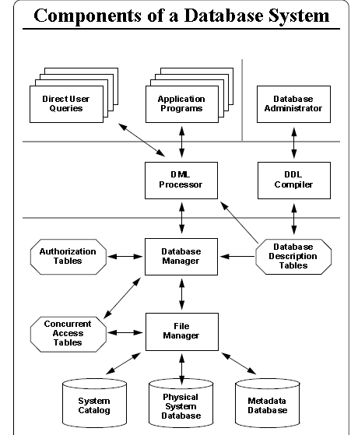
Components of a Database System

Slide 25
Summary
Database Terminologies
Database System Applications
Purpose of Database Systems
View of Data
Components of a DBMS

Slide 26
Thank You
Happy to answer any questions ! ! !
Notes:
Not covering all.

